Slide 1
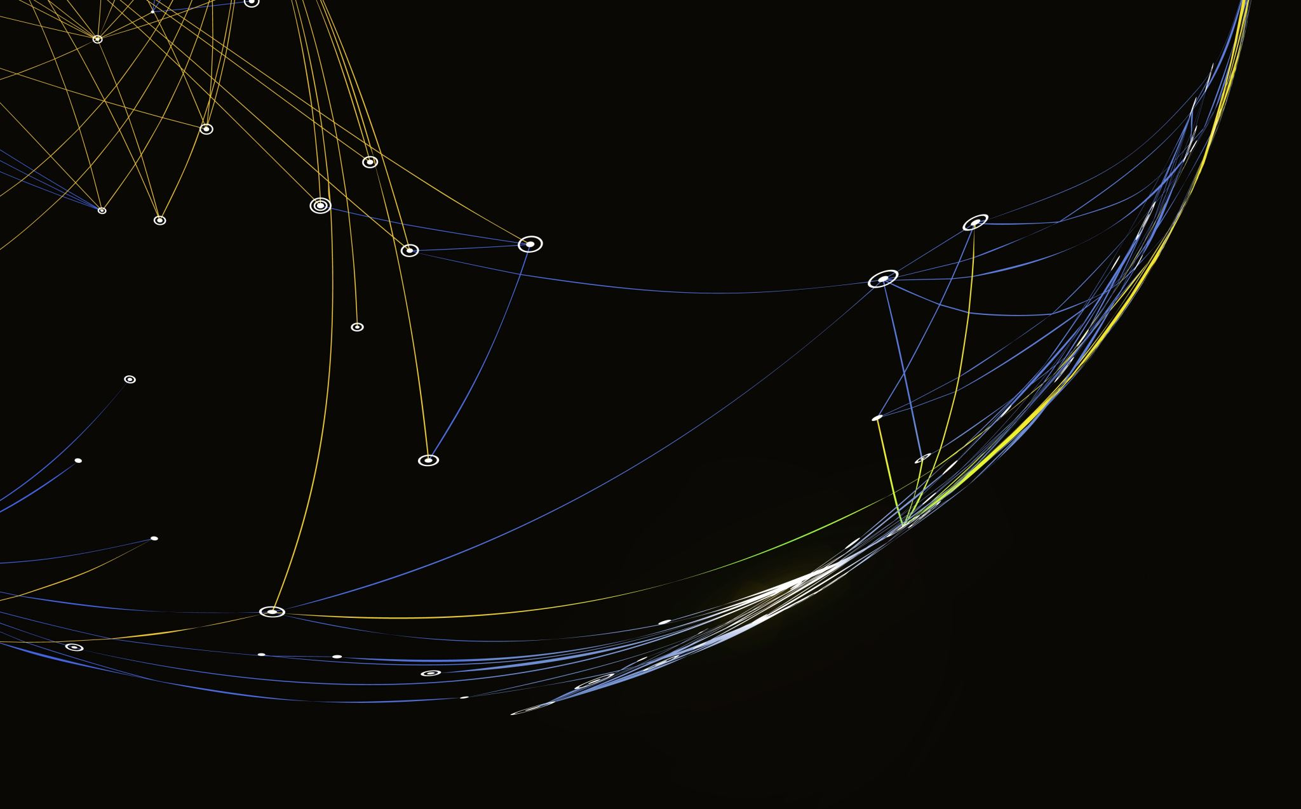
My Projekt – Game chooser
Präsentation by Afonso

Slide 2
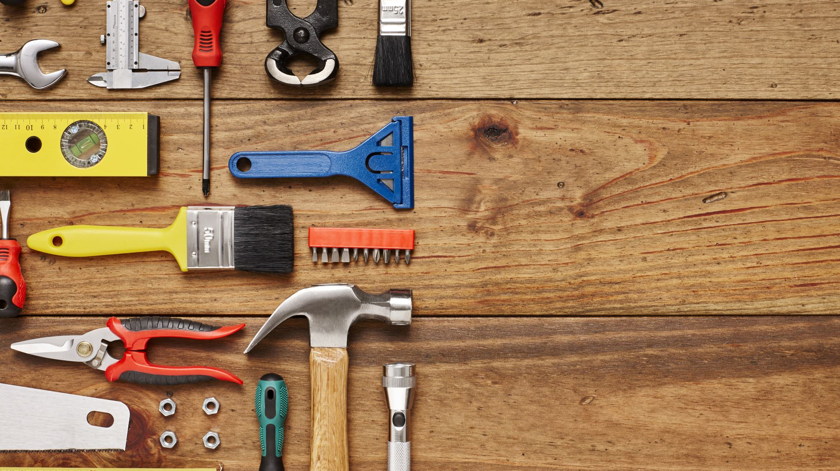
What Tools did i Use

Slide 3
What went well

Slide 4
What went wrong

Slide 5

What would I change
Better coordination and better planning
More Research
Not giving up so fast

